Slide 1
Deep Face Recognition based Non-Vaccinated Population Finder and Alert System
SUBMITTED BY
MARY SONA P A (960518104021)
NITHYA A (960518104026)
SUBREENA BANO (960518104045)
SANTHOSHINI KM (960518104306)

Slide 2
Abstract
Vaccinations are an important and effective cornerstone of preventive medical care with significant health benefits.
The government has started vaccination to prevent the continuous spread of corona infection in India.
Address ubiquitous problem: the widespread hesitancy toward or downright rejection of vaccination.
Proposed an Aadhaar-based facial recognition system is used to find non vaccinated citizen and alert them using Artificial Intelligence.
Finally its provides COVID-19 vaccination status using their face and attest that an individual has received a vaccine or not and alert them to get vaccinated.

Slide 3
Introduction
The industry around facial recognition technology is rapidly maturing due to advances in AI, ML and deep learning technologies.
ML is used in computer vision to derive meaningful insights from images, videos, and visual inputs
Facial recognition is a technology that is capable of recognizing a person based on their face.
It employs machine learning algorithms which find, capture, store and analyze facial features in order to match them with images of individuals in a pre-existing database.

Slide 4
Literature Survey
Title & Year | Technology | Demerits | Platform | Outcome
CaptureIt! - A Web-based Attendance System Using Face Recognition. 2021, Shreyas More | Machine Learning, SVM | Manually on the camera and take attendance | Python | teachers to analyze in a contactless but efficient manner
Covid-19 Based Automated Screening System. 2021,Hwanjin Yong | Deep Learning | Face mask detection only. | Python and IoT device for temperature reading | feasible yet an effective solution to the problems posed.
SafeCampus: Multimodal-based Campus-wide Pandemic Forecasting.2021, Sidi Lu; | LSTM model | Face Mask finder and count the infected based on their temperature. | MobileNetV2 | important observations with supporting evidence are presented.
Design and Implementation of Entrance Guard System Based on Face Recognition.2020, Jianfeng Ye | SVM | problems of the overexposure or underexposure of image acquisition in face recognition. | Java | The method is simple and convenient in design, high in reliability and easy to implement in installation.

Slide 5
Existing Method
There are many existing FR methods that achieve a good performance
SVM,
Linear Discriminant Analysis (LDA),
Bayesian Network (BN),
Neural Network (NN),
Gaussian mixture model (GMM), AdaBoost, PCA.
Face Recognition Applications are Attendance System, Security System and Smart Home Automation System.
Face recognition based voting system are proposed

Slide 6
Disadvantages
The accuracy of the system is not 100%.
Face detection and loading training data processes just a little bit slow.
It can only detect face from a limited distance.
The instructor and training set manager still have to do some work manually.
Handcrafted feature
High Computational Complexity

Slide 7
Problems Identified
Vaccination is crucial to limit the pandemic spread of SARS-CoV-2/COVID-19.
History revealed poor utilization of flu vaccine introduced after H1N1 pandemic.
COVID-19 digital certificate to show proof of only COVID-19 vaccinations in India.
False certificates can pose a significant risk to public health.
To achieve population immunity first we have to find the non-vaccinated population.
Using facial recognition at vaccine centers risks further marginalizing vulnerable people who may be misidentified and refused the vaccine, and raises fears the controversial technology could become the norm at all centers.

Slide 8
Proposed Method
This project provides COVID-19 vaccination status using their face and attest that an individual has received a vaccine or not and alert them to get vaccinated.
Proposed an Aadhaar-based facial recognition system is used to find non vaccinated citizen and alert them using Artificial Intelligence.
Deep learning in the form of Convolutional Neural Networks (CNNs) to perform the face recognition.
Alert System

Slide 9
Advantages
The system stores the faces that are detected and automatically marks vaccinated or not or Dose 1.
Provide authorized access.
Multiple face detection.
Provide methods to maximize the number of extracted faces from an image.
Ease of use.
Manipulate and recognize the faces in real time using live video data.
Multipurpose software.
Can be used in different places.
Vaccination Alert
Vaccination Certificate with Face and QR

Slide 10

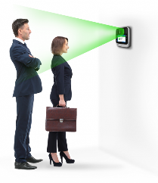
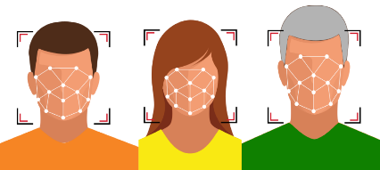
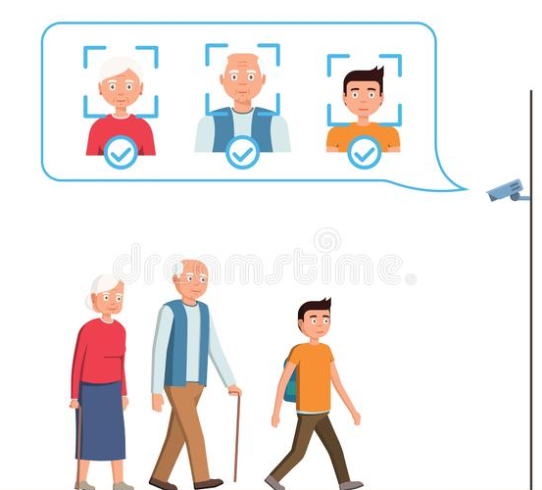


System Architecture
CCTV Capture Face
Office
Aadhar Database
CNN Classification
Feature Extraction
Prediction
Public Place
RNN Face Detection
Preprocessing
Convert into Frames
Vaccinated or Non-Vaccinated
Capture Face
Book Vacc.Apointment
Allow or Not Allow
Aadhar Face Enrollment Center
Verification Authority

Slide 11
Algorithm
RPN – It is used to detect the faces
DCNN- To classify and recognize the face
Non Vaccination Finder with Aadhar Database

Slide 12

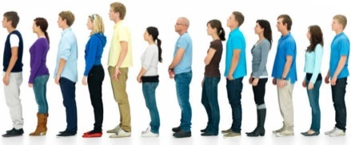
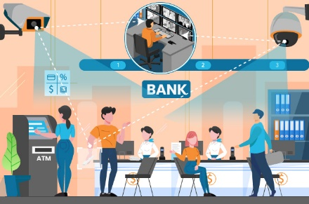



Algorithm Flow
Enrolment
Verification
Face Data Set acquisition
Preprocessing
Face Detection
Preprocessing
Face Detection
Face Recognition
Feature Extraction
Face Recognition
Classification
Feature Extraction
Classification
Classified Result
Student Database Server
Matching
Admin
Non-Vaccinated
Vaccinated

Slide 13
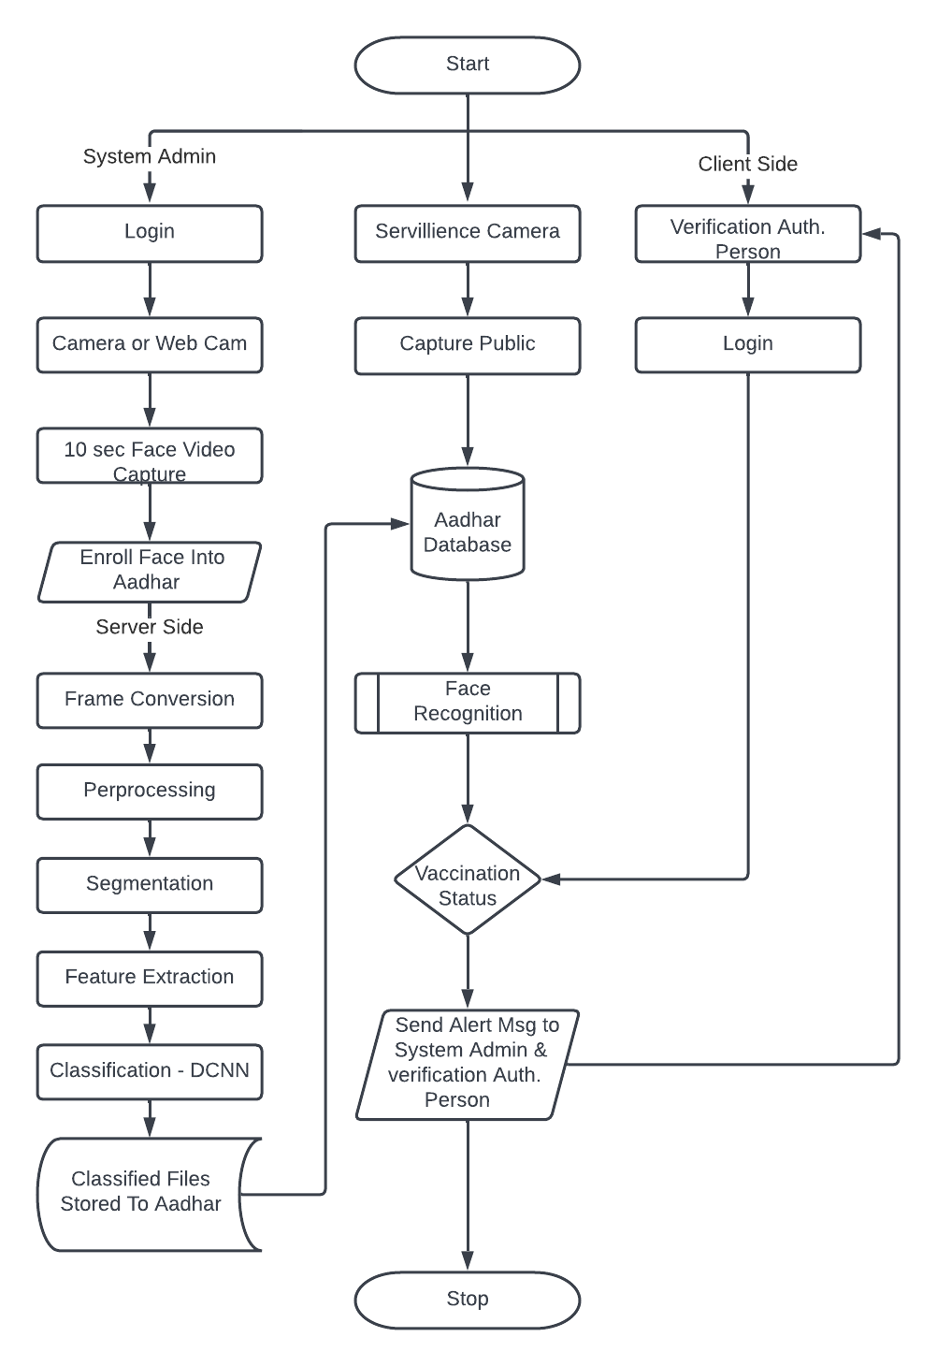
Flow Chart

Slide 14
DCNN Face recognition
Face Alignment – Faces that are turned away from the focal point look totally different to a computer. An algorithm is required to normalize the face to be consistent with the faces in the database. For example, the bottom of the chin, the top of the nose, the outsides of the eyes, various points around the eyes and mouth, etc.
Face Detection – The machine must first locate the face in the image or video.
Feature Measurement and Extraction – This step requires the measurement and extraction of various features from the face that will permit the algorithm to match the face to other faces in its database.
Face Recognition – Using the unique measurements of each face, a final ML algorithm will match the measurements of the face against known faces in a database.
Face Verification – Face verification compares the unique properties of a given face to another face. The ML algorithm will return a confidence value to assess whether the faces match or not.

Slide 15
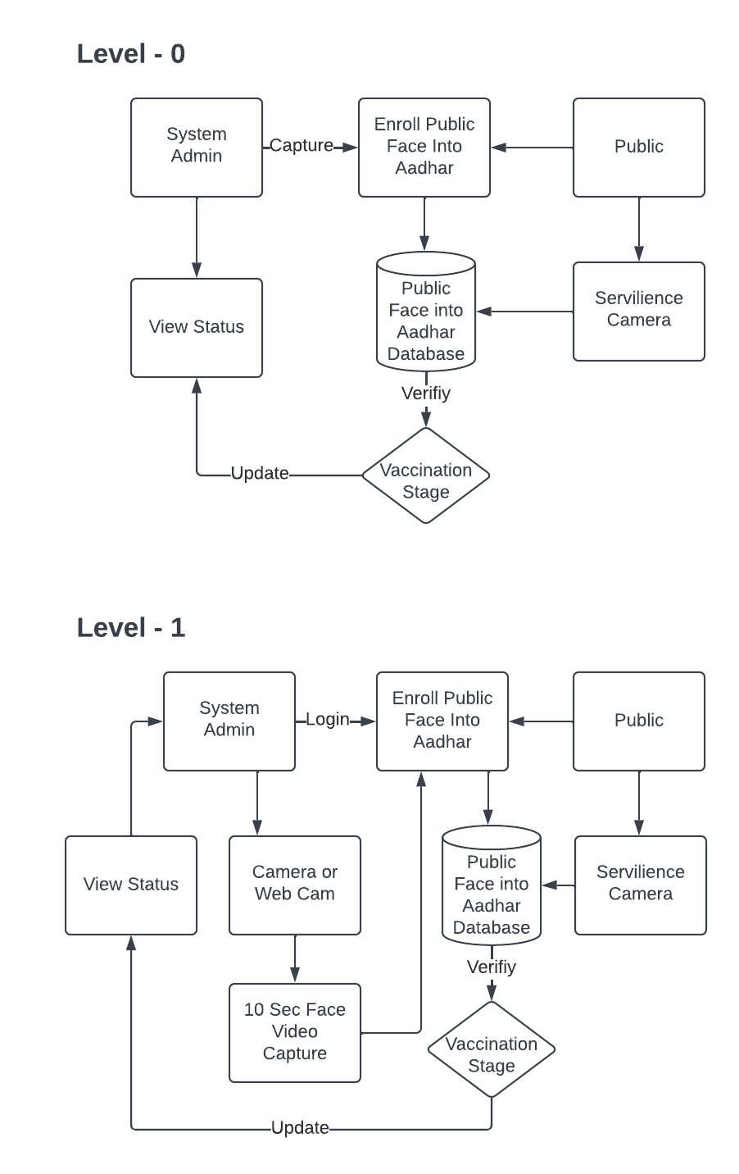
Data Flow Diagram –Level 0

Slide 16
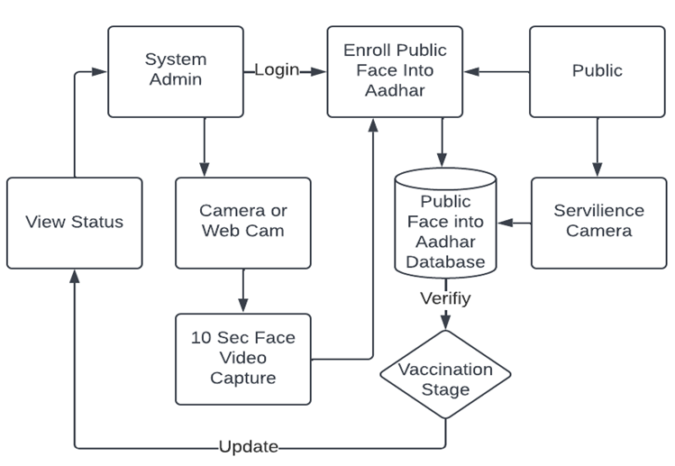
Data Flow Diagram –Level 1

Slide 17
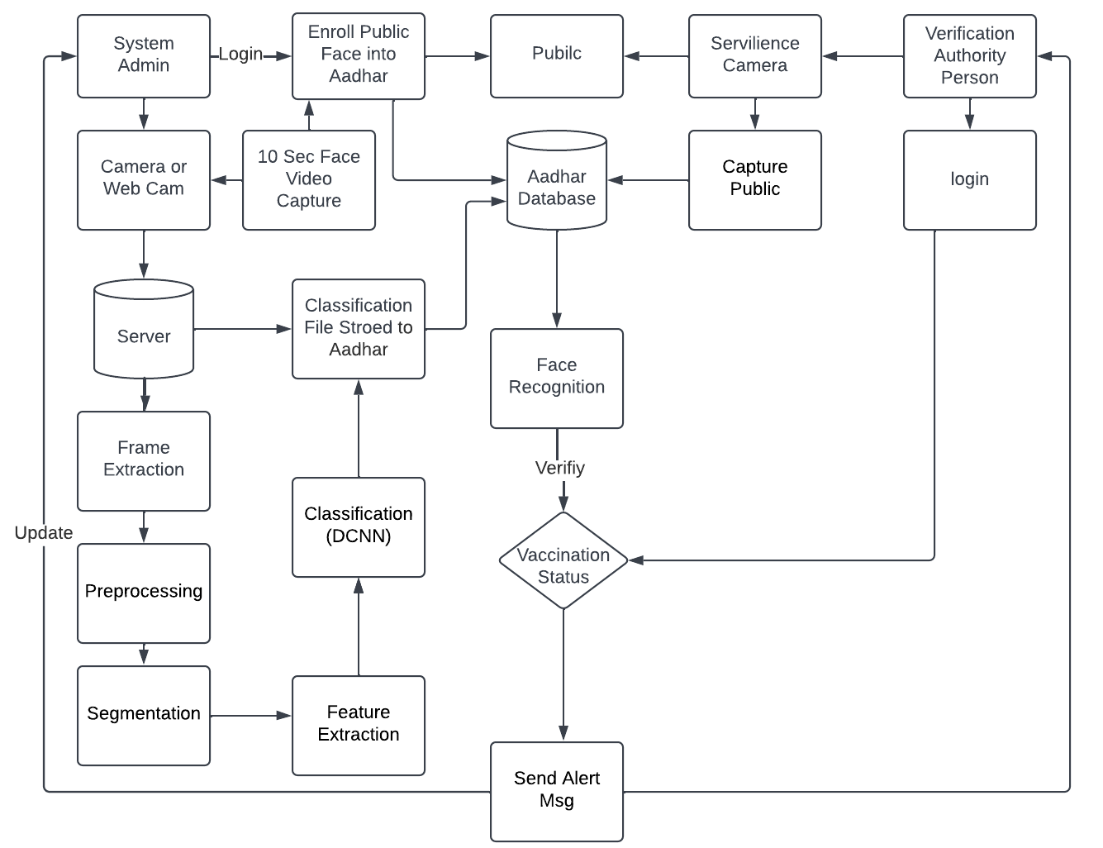
Data Flow Diagram –Level 2

Slide 18
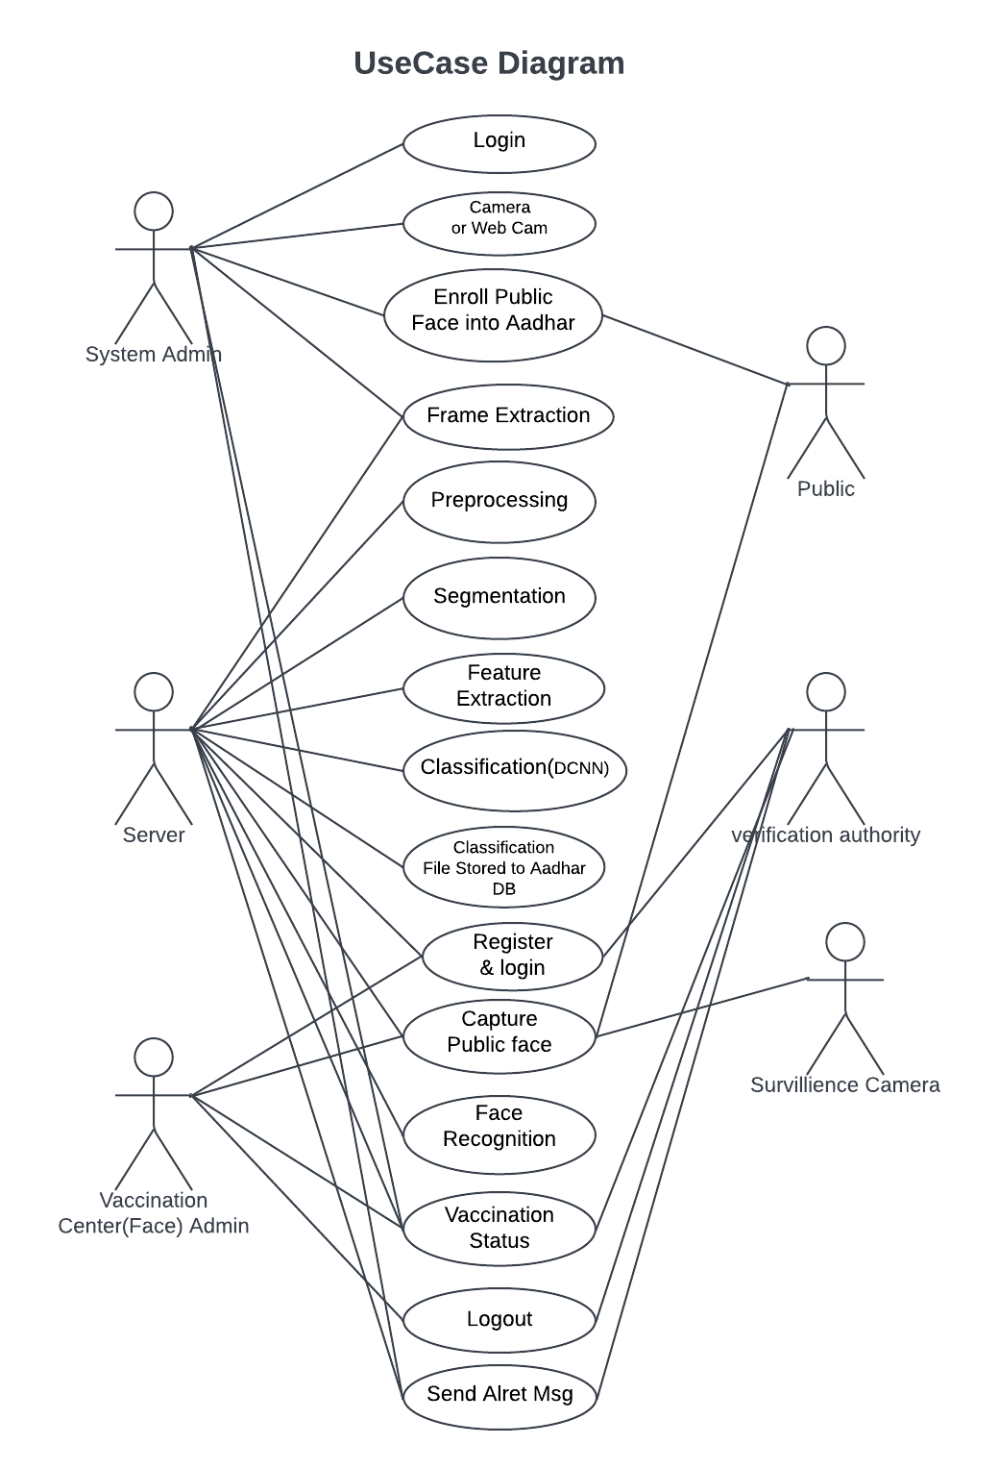
UML Diagram –Use Case

Slide 19
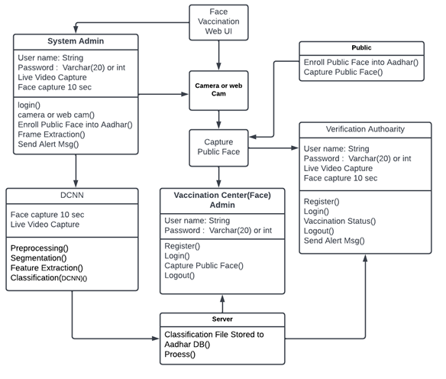
UML Diagram –Class Diagrams

Slide 20
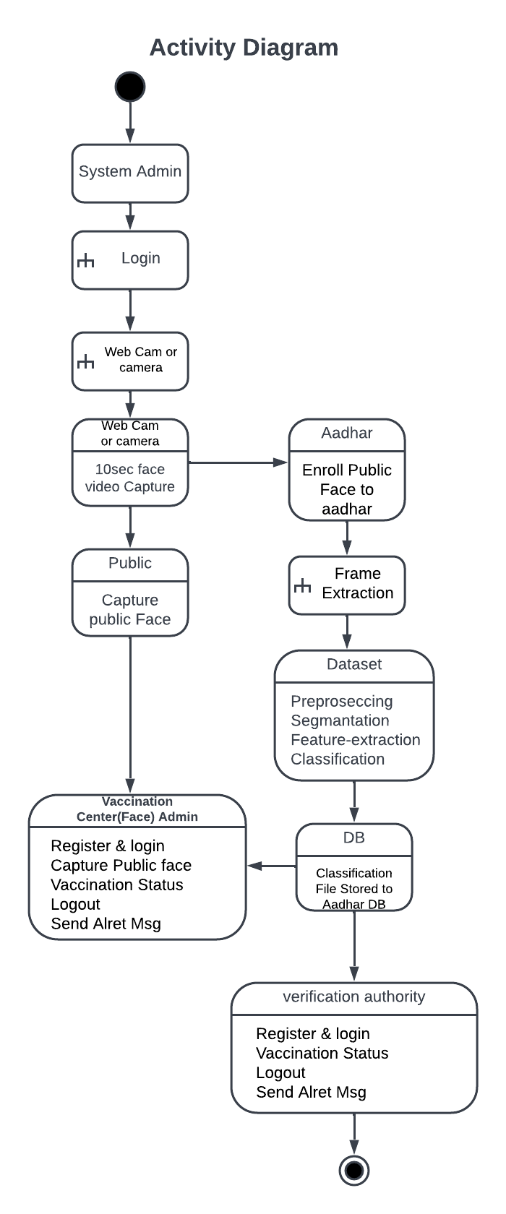
UML Diagram – Activity Diagrams

Slide 21
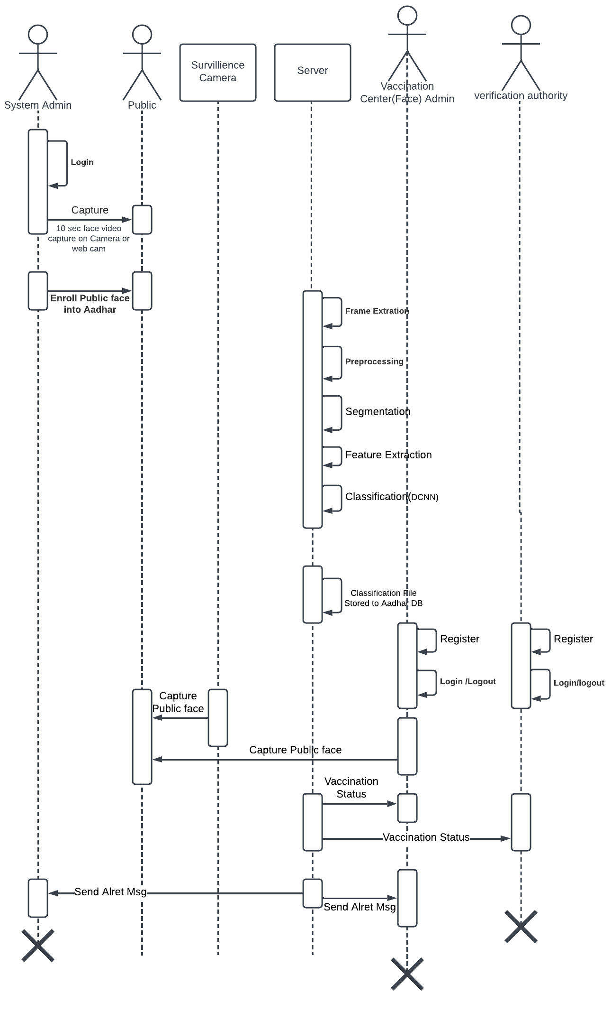
UML Diagram – Sequence Diagrams

Slide 22
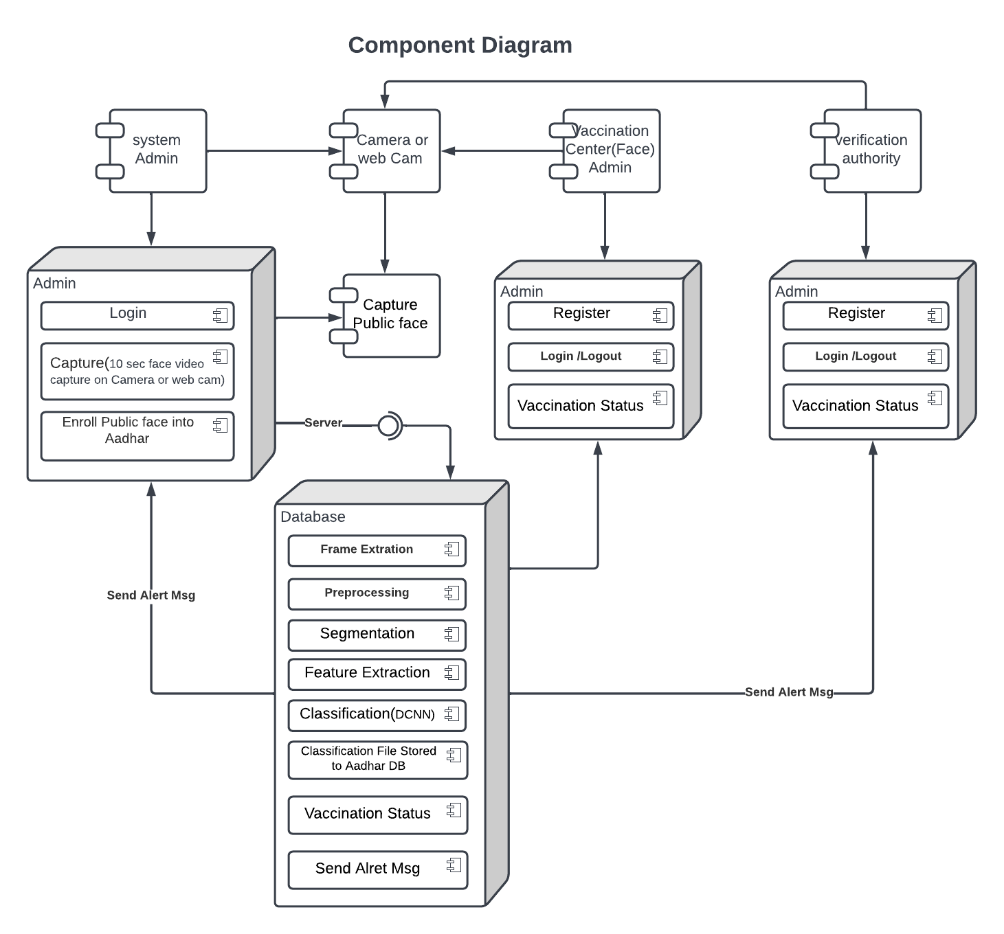
UML Diagram – Component Diagrams

Slide 23
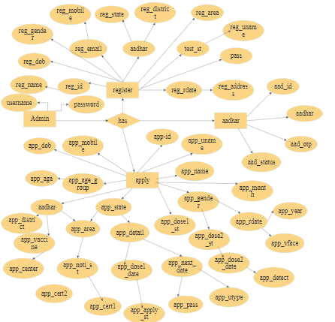
ER – Diagram –Enrollment

Slide 24
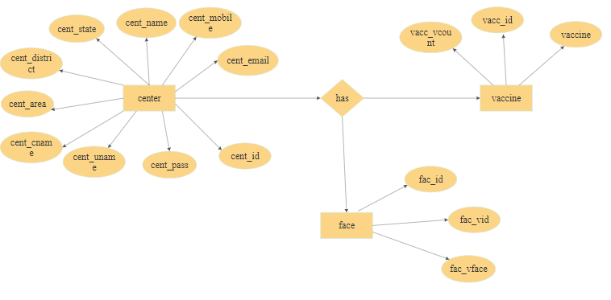
ER – Diagram –Verification

Slide 25
MODULES LIST
Non-Vaccination Finder
Web APP
Mobile App
Face Enrollment Module
Face Enrollment
Face Verification Module
Face Verification
Non-Vaccination Finder
Alert System
Performance Analysis

Slide 26
Modules Description
Non-Vaccination Finder
In this portal an Aadhaar-based facial recognition system is developed to find Covid-19 vaccination finder across the country in order find to Non-Vaccinated Population.
Two types of access
Web APP
Mobile App

Slide 27
2. Face Registration Module
2.1. Face Enrollment
This module begins by registering a few frontal face of Aadhar Database.
With each pose, the facial features including eyes, nose and mouth is automatically
DCNN algorithms were also created to automatically detect and reject improper face images during the enrollment process.
Face video acquisition, preprocessing , segmentation, feature extraction and classification are taken place.

Slide 28
3. Face Verification Module
After capturing the face image from the Camera which is deployed in public or private organization, the image is given to face detection module.
This module detects the image regions which are likely to be human. After the face detection using RPN, face image is given as input to the feature extraction module to find the key features that will be used for classification.
The module composes a very short feature vector that is well enough to represent the face image.
Here, it is done with DCNN with the help of a pattern classifier, the extracted features of face image are compared with the ones stored in the face database.
The face image is then classified as either vaccinated or Nonvaccinated.

Slide 29
4. Non-Vaccination Finder
This module is capable of identifying or verifying a non-Vaccination person by comparing and analyzing patterns, shapes and proportions of their facial features and contours from the trained classified file.
When a facial image (probe image) is entered into the system it is automatically encoded by an algorithm and compared to the profiles already stored in the Aadhar database system

Slide 30
5. Alert System
This module provides COVID-19 vaccination status using their face and attest that an individual has received a vaccine or not and alert them to get vaccinated.

Slide 31
5. Performance Analysis
The performance analysis of all experiments was based on the most common evaluation measures used for statistical tests, such as accuracy, precision, recall, and f_measure.

Slide 32
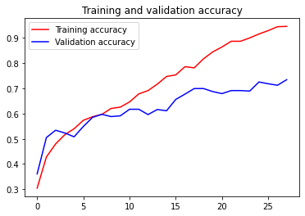
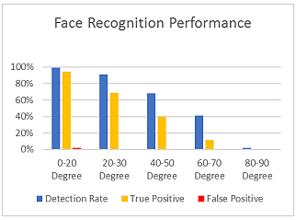
Face Recognition Accuracy and Performance

Slide 33
CNN Face Recognition System
Detect/identify faces in an image (using a face detection model) — for simplicity, this tutorial will only use images with one face/person in it, not more/less
Predict face poses/landmarks (for the faces identified in step 1)
Using data from step 2 and the actual image, calculate face encodings (numbers that describe the face)
4. Compare the face encodings of known faces with those from test images to tell who is in the picture

Slide 34
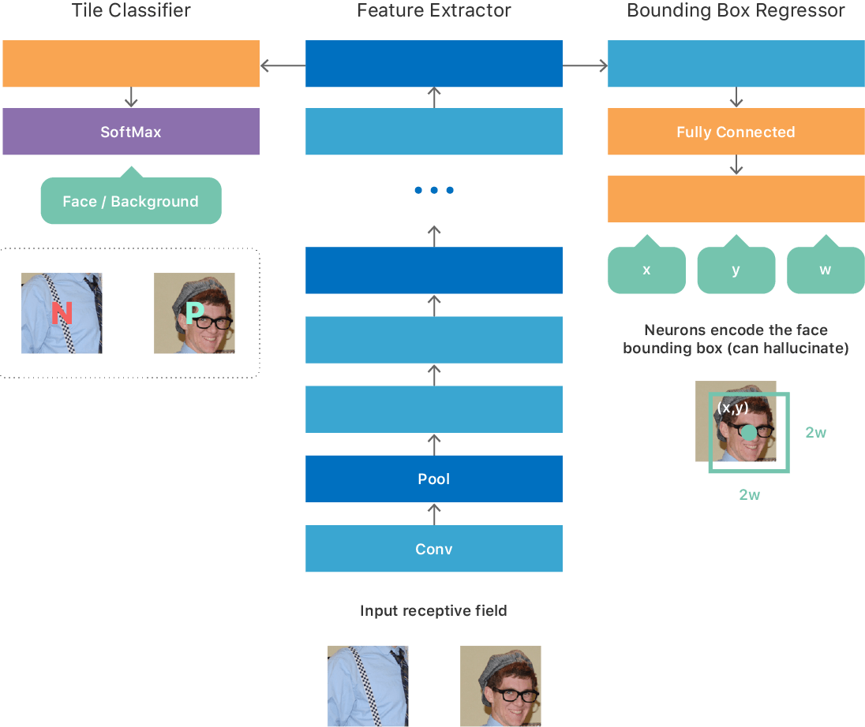
DCNN Architecture for Face Detection

Slide 35
Input and Output
Input : Live Video
Output : Vaccinated or Non Vaccinated

Slide 36
Future Enhancement
In Future this project proposes to predict the likely location of a missing person for a number of at risk groups.
And also this project can be implement for voting system.

Slide 37
Conclusion
In the context of the coronavirus disease (COVID-19) pandemic, AI based face recognition of citizen’s current vaccination status to protect against COVID-19 can then be used for continuity of care or as proof of vaccination for purposes other than health care.
This project provides COVID-19 vaccination status using their face and attest that an individual has received a vaccine or not and alert them to get vaccinated.

Slide 38
References
Y. Dong, T. Dai, Y. Wei et al., "A systematic review of SARS-CoV-2 vaccine candidates", Sig Transduct Target Ther, vol. 5, pp. 237, 2020.
S. P. Kaur and V Gupta, "COVID-19 Vaccine: A comprehensive status report", Virus research, vol. 288, pp. 198114, 2020, [online] Available: https://doi.org/10.1016/j.virusres.2020.198114.
.J. C. Abdul-Mutakabbir et al., "A three-tiered approach to address barriers to COVID-19 vaccine delivery in the Black community", Lancet Glob. Heal, 2021.
P. Dou and I. A. Kakadiaris, “Multi-view 3D face reconstruction with deep recurrent neural networks,” Image and Vision Computing, vol. 80, pp. 80–91, 2018.
X. Shao, J. Lyu, J. Xing et al., “3D face shape regression from 2D videos with multi-reconstruction and mesh retrieval,” in Proceedings of the IEEE International Conference on Computer Vision Workshops, Seoul, Republic of Korea, October 2019.
F. Wu, L. Bao, Y. Chen et al., “MVF-Net: Multi-view 3d face morphable model regression,” in Proceedings of the IEEE Conference on Computer Vision and Pattern Recognition, pp. 959–968, Long beach, CA, USA, June 2019.

Slide 39
References
7. H. Zhou, P. Chen, and W. Shen, “A multi-view face recognition system based on cascade face detector and improved Dlib,” in MIPPR 2017: Pattern Recognition and Computer Vision, Xiangyang, China, March 2018.
8. B. Renuka, B. Sivaranjani, A. M. Lakshmi, and D. N. Muthukumaran, “Automatic enemy detecting defense robot by using face detection technique’,” Asian Journal of Applied Science and Technology, vol. 2, no. 2, pp. 495–501, 2018.
9. X. Sun, P. Wu, and S. C. H. Hoi, “Face detection using deep learning: An improved faster RCNN approach,” Neurocomputing, vol. 299, pp. 42–50, 2018.
10. E. Zhou, Z. Cao, and J. Sun, “Gridface: Face rectification via learning local homography transformations,” in Proceedings of the European Conference on Computer Vision (ECCV), pp. 3–20, Munich, Germany, September 2018.
11. K. Zhang, Z. Zhang, Z. Li, and Y. Qiao, “Joint face detection and alignment using multitask cascaded convolutional networks,” IEEE Signal Processing Letters, vol. 23, no. 10, pp. 1499–1503, 2016.
12. T. Zhang, W. Zheng, Z. Cui, Y. Zong, J. Yan, and K. Yan, “A deep neural network-driven feature learning method for multi-view facial expression recognition,” IEEE Transactions on Multimedia, vol. 18, no. 12, pp. 2528–2536, 2016.
13. S. S. Farfade, M. J. Saberian, and L.-J. Li, “Multi-view face detection using deep convolutional neural networks,” in Proceedings of the 5th ACM on International Conference on Multimedia Retrieval, pp. 643–650, Shanghai, China, June 2015.

Slide 40
References
14. StatsTV. (2021, 06) Top Countries with COVID-19 Vaccination Doses Administered
15. Michael BA Oldstone, "Viruses plagues and history: past present and future" in , Oxford University Press, 2020.
16. "Guidance on developing a national deployment and vaccination plan for COVID-19 vaccines: interim guidance", June 2021.
17. Robert Verity et al., "Estimates of the severity of COVID-19 disease", MedRxiv, 2020.
18. C. Todd Lopez, Operation Warp Speed Accelerates COVID-19 Vaccine Development, [online] Available: https://www.defense.gov/Explore/News/Article/Article/2222284/.
19. E. Israfilova, A. Arslan, N. Yildrim and T. Kaya, "Influencer Identification System Design Using Machine Learning Techniques" in Intelligent and Fuzzy Techniques in Big Data Analytics and Decision Making, Springer, January 2021.
20. E. Mathieu, H. Ritchie, E. Ortiz-Ospina et al., "A global database of COVID-19 vaccinations", Nat Hum Behave, 2021.

Slide 41
Thank You

Slide 42
Organization of the Presentation
Objective
Abstract
Introduction
Literature Survey
Existing System
Proposed System
System Requirements
Modules List
References

Slide 43
Domain – AI
Artificial intelligence is the simulation of human intelligence processes by machines, especially computer systems.
Using these technologies, computers can be trained to accomplish specific tasks by processing large amounts of data and recognizing patterns in the data.
Every industry has a high demand for AI capabilities – including systems that can be used for automation, learning, legal assistance, risk notification and research.

Slide 44
Sub Domain : Machine Learning
Machine learning (ML) is a type of artificial intelligence (AI) that allows software applications to become more accurate at predicting outcomes without being explicitly programmed to do so.
Machine learning algorithms use historical data as input to predict new output values.

Slide 45
Objective
The objective of the project is to find the non vaccinated citizen and alert them using Face Recognition enabled Aadhar system.
To provides COVID-19 vaccination status using their face and attest that an individual has received a vaccine or not and alert them to get vaccinated.
To train and test the face samples with deep learning algorithm.

Slide 46
Software Specification
Python 3.7.4(64-bit) or (32-bit)
Flutter
Flask 1.1.1
MySQL 5.
Wampserver 2i
TensorFlow, Pandas, Keras
Windows OS and Android OS

